Slide 1
Expansion Strategy for SELCO India
Team Resilient Architects:
Piyush Mehta: Head of Leadership Department
Riya Jolly: Head of Human Resource Management Department
Mohammad Suhail: Head of Financial Management Department
Aditya Sonawane: Head of Marketing Management Department
Astha Singh: Head of IT & BA Management Department

Slide 2
TABLE OF CONTENTS
01
02
03
04
05
06
Case
Description
Current Industry Scenario
Product Line Expansion
07
Suggestions
For Departments
Sales Network
Expansion
Energy Service
Center Expansion
Proposed
Expansion Plans

Slide 3
01
Case Description: SELCO India

Slide 4
Case Description SELCO India: Empowering Rural Communities Bridging the Energy Gap
SELCO India, a pioneer in rural energy solutions
Mission: Providing solar electricity to underserved communities
Innovative approach, customized solutions for diverse customer segments
Strong partnerships with banks and microfinance institutions
Despite these commendable strategies and initiatives, SELCO's impact is still limited
Over two decades, the company has been able to reach approximately 450,000 households
SELCO must embark on a journey of geographical expansion and broaden its range of offerings

Slide 5
Goals of Expansion
To expand the reach of SELCO's products and services to more rural communities in India
To develop new products and services that meet the specific needs of rural customers
To make SELCO's products and services more affordable and accessible to rural customers

Slide 6
02
Current Industry Scenario

Slide 7
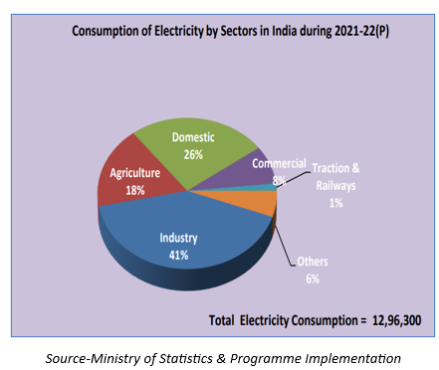
India's Energy Landscape A Shifting Paradigm
Robust economic growth in India
Rapid increase in energy consumption
Commitment to achieving net-zero emissions by 2070
Transition from non-renewable to renewable energy sources
Government incentives: Grid-Connected Solar Rooftop Scheme, VGF schemes
Solar energy as a frontrunner with versatile applications

Slide 8
03
Product Line Expansion

Slide 9
Expanding Product Offerings Meeting Diverse Needs
Current SELCO solution offerings: Households, Livelihoods, Institutions
New Product Line: Focus on rural market segment
Agriculture-related solutions: Solar-powered irrigation systems, pumps, threshers, sprayers, dryers, and tillers
Standardizing Product Designs for scalability
Innovations for existing consumer categories
Solar-based Mini Grids for affordability
Current Offerings:

Slide 10
Sales Network Expansion
04

Slide 11
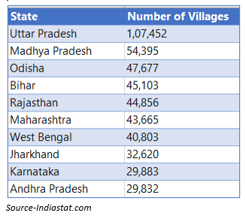
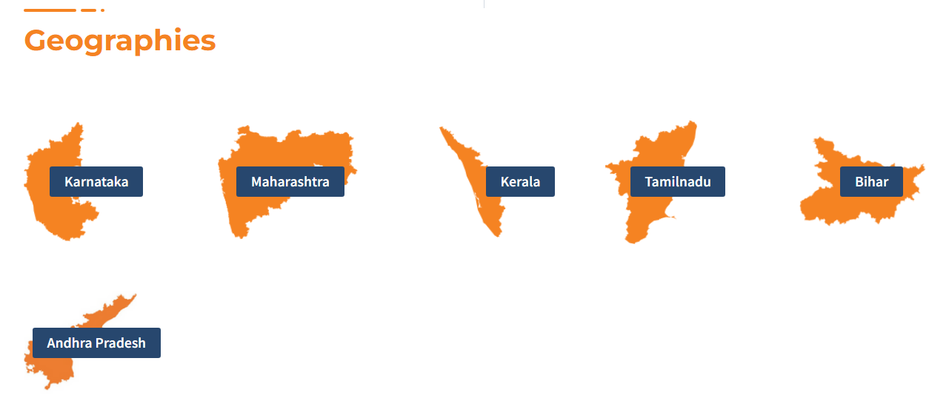
Broadening Market Reach Untapped Potential
Current footprint: Karnataka, Kerala, Maharashtra, Bihar, Tamil Nadu, and Andhra Pradesh
Top 10 states with high village count: Uttar Pradesh, Madhya Pradesh, Odisha (Untapped)
Partnering with local businesses to reach wider audiences
Mobile Marketing Vans for effective outreach
Kiosk Centers for one-on-one engagement
Village Council Gatherings for building trust
Regional Sales Representatives for local connection
Text/SMS and Social Media Marketing for rural penetration

Slide 12
05
Energy Service Center Expansion

Slide 13
Enhancing Customer Support Accessible Service Centers
New Energy Service Centers in rural areas
Partnering with local businesses to operate service centers
Mobile Energy Service Centers for remote areas
Technology for efficient customer service
Collaboration with other organizations for greater impact

Slide 14
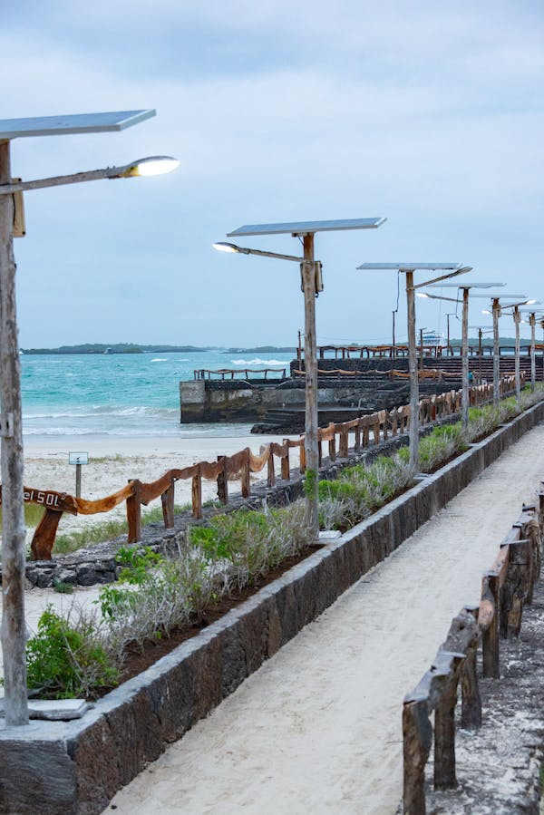
06
Proposed Expansion Plans

Slide 15
Expansion Strategies Pathways to Growth
Focus on expanding product offerings
Test new products with existing customers
Raise awareness and boost sales
Reinvest profits and secure capital
Expand geographically after analyzing the external environment
Set up necessary infrastructure
Capture a larger market share
Plan B: Product Line Expansion
Expand to specific untapped geographies
Establish necessary infrastructure
Enter the market with existing products
Reinvest profits and secure capital
Expand the product line
Test new products with existing clientele
Scale the business if successful
Plan A: Geographic Expansion

Slide 16
07
Suggestions For Departments

Slide 17
Suggestions for Different Departments Roles for Success
Finance Department: Forecasting, Financing, and Monitoring
HR Department: Recruitment, Training, and Competitive Compensation
Marketing Department: Market Research, Partnerships, and Sales Strategies
IT Department: Centralized Systems, Customer Support, and Efficient Complaint Tracking

Slide 18
THANKS! Team Resilient Architects

